Slide 1
Real Algorithm
Just started

Slide 2
Algorithm
STEP TO SOLVE PROBLEM
STEP1: ANALYS INSTRUCTION (UNDERSTAND INSTRUCTION)
STEP2: DRAW FLOW CHAT TO UNDERSTAND CODE FLOW
STEP3: WRITE CODE

Slide 3
TRY TO WRITE CODE FOLLOWING FLOWCHAT
N = 0
REPEAT<10>
IF N > 10
FALSE
PRINT(“OK”)
PRINT(“Hello”)
TRUE
PRINT(“Hello”)

Slide 4
Write code following output below
Case 1
N = INPUT
> 2
Hello
Hello
>
REPEAT<N>
Case 2
> 5
Hello
Hello
Hello
Hello
Hello
>
PRINT(“Hello”)

Slide 5
Write code following output below
Case 1
> 2
> 4
Result: 6
>
Case 2
> 5
> 8
Result: 13
>

Slide 6
Write code following output below
Case 1
> 2
> 4
Result: 8
>
Case 2
> 5
> 8
Result: 40
>

Slide 7
Write code following output below
Case 1
> 2
Result: 4
>
Case 2
> 5
Result: 25
>

Slide 8
Write code following output below
Case 1
> 2
Even number
>
Case 2
> 5
Odd number
>

Slide 9
Write code following output below
Case 1
n = int(input())
if n < 0:
print("Nagative number")
elif n > 0:
print("Positive number")
else:
print("Center number")
> -2
Negative number
>
Case 2
> 5
Positive number
>
Case 3
> 0
Center number
>

Slide 10
Write code following output below
Case 1
> Hello
0
1
2
3
4
>
text = len(input())
for i in range(text):
print(i)
> hi
0
1
>
Case 2

Slide 11
Write code following output below
text = input()
result = len(text)
for i in range(result):
print(text[i])
Case 1
> Hello
H
e
l
l
o
>
> hi
h
i
>
Case 2

Slide 12
Write code following output below
result = ""
text = len(input())
for i in range(text):
result = result + "M"
print(result)
Case 1
> Hello
MMMMM
>
> hi
MM
>
Case 2

Slide 13
Write code following output below
Case 1
> Hello
A not found
>
n = 0
text = input()
result = len(text)
for i in range(result):
if text[i] == "a":
n = n + 1
if n < 0:
print(n ,"A in text")
else:
print("A not found")
> Banana
3 A in text
>
Case 2

Slide 14
Write code following output below
First number must be greater than second number
Case 1
> 1
> 4
2
3
>
n = int(input())
n2 = int(input())
while n < n2 and n != (n2 - 1):
n = n + 1
print(n)
Case 2
> 3
> 9
4
5
6
7
8
>

Slide 15
Write code following output below
Case 1
> 1
> 4
> 8
8 is bigger than other
>
n1 = input()
n2 = input()
n3 = input()
if n1 > n2 and n1 > n3:
print(n1 ,"is bigger than other")
elif n2 > n1 and n2 > n3:
print(n2 ,"is bigger than other")
else:
print(n3 ,"is bigger than other")
Case 2
> 3
> 9
> 6
9 is bigger than other
>

Slide 16
Write code following output below
Enter 5 times and sum all numbers
Case 1
> 1
> 4
> 8
> 3
> 2
Sum: 18
>
sum = 0
for i in range(5):
n = int(input())
sum = sum + n
print("Sum:", sum)
Case 2
> 1
> 1
> 2
> 3
> 6
Sum: 13
>

Slide 17
Write code following output below
Enter until find number 7
Case 1
> 1
> 4
> 8
> 3
> 7
Good bye!
>
n = 0
while n != "7":
n = input()
print("Good bye!")
Case 2
> 1
> 1
> 7
Good bye!
>

Slide 18
Write code following output below
Enter until find number 7 display “Good bye!” otherwise display “Try again!”
Case 1
> 1
Try again!
> 3
Try again!
> 7
Good bye!
>
n = 0
while n != "7":
n = input()
if n != "7":
print("Try again!")
print("Good bye!")
Case 2
> 1
Try again!
> 7
Good bye!
>

Slide 19
Write code following output below
Case 1
> 4
x
xx
xxx
xxxx
text =""
n = int(input())
for i in range(n):
text = text + "x"
print(text)
Case 2
> 2
x
xx

Slide 20
Write code following output below
Case 1
> 4
xxxx
xxx
xx
x
text =""
n = int(input())
for i in range(n):
text = text + "x"
for i in range(n):
text = text[:-1]
print(text)
Case 2
> 2
xx
x

Slide 21
Write code following output below
Case 1
result =""
text = input()
text2 = len(text)
for i in range(text2):
if text[i] != "a":
result += text[i]
if text[i] == "a":
result += "*"
print(result)
> abababa
> *b*b*b*
Case 2
> acdefgaca
> *cdefg*c*

Slide 22
Write code following output below
Case 1
> abacdef
> *#*#cdef
result =""
text = input()
text2 = len(text)
for i in range(text2):
if text[i] == "a":
result += "*"
elif text[i] == "b":
result += "#"
else:
result += text[i]
print(result)
Case 2
> acbefbaca
> *c#ef#*c*

Slide 23
Write code following output below
Case 1
> hello
> olleh
result =""
text = input()
text2 = len(text)
for i in range(text2):
result += text[-(i +1)]
print(result)
Case 2
> hi
> ih

Slide 24
Write code following output below
Case 1
> hello
> HELLO
text1 = input()
text1 = text1.upper()
print(text1)
Case 2
> HI
> HI

Slide 25
Write code following output below
Case 1
result = 0
text = input()
text2 = len(text)
for i in range(text2):
if text[i].isupper():
result += 1
if result == 0:
print("No uppercase letter")
else:
print(result ,"uppercase letter")
> hello
No uppercase letter
Case 2
> HI
2 uppercase letter

Slide 26
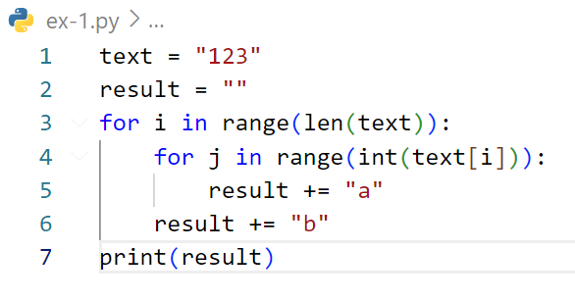
Find output of code below
Answer= abaabaaab

Slide 27
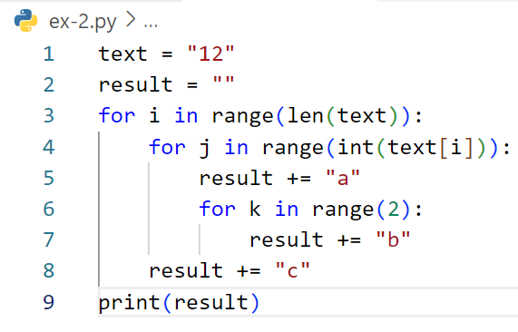
Find output of code below
Answer:abbcabbabbc

